Slide 1

Cyber Security

Slide 2
Outline
Attacks, services and mechanisms
Security attacks
Security services
Methods of Defense
A model for Internetwork Security
Internet standards and RFCs

Slide 3
Security?
What does it refer to?
Three Fundamentals
  Confidentiality
    Authorized users get entry
    Inspection of information, printing of information and knowledge of resource existence
  Availability
    Legitimate user be able to access resources and service should be provided at anytime
  Integrity
    Changed in adequate way
    Modification done by authorized people

Slide 4
Security Goals
Confidentiality
Integrity
Availability

Slide 5
Attack Process
Three stages called MOM
Method
  Ability, information, tools
Opportunity
  Time and Access
Motive
  Testing system reliability
  Competition between attackers or testing their own skills
  Breaking into well secured systems like law enforcement, government agencies
  To gain popularity, financial gain, information gain
  Just for fun
  No motive at all

Slide 6
The OSI (open systems interconnection) security architecture
Security Attack: Any action that compromises the security of information.
Security Mechanism: A mechanism that is designed to detect, prevent, or recover from a security attack.
Security Service: A service that enhances the security of data processing systems and information transfers. A security service makes use of one or more security mechanisms.

Slide 7
Security Attacks
Passive Attack
Passive attacks are in the nature of eavesdropping on, or monitoring of, transmissions. The goal of the opponent is to obtain information that is being transmitted
  attempts to learn or make use of information from the system but does not affect system resources
Active Attack
  attempts to alter system resources or affect their operation
  Active attacks involve some modification of the data stream or the creation of a false stream and can be subdivided into four categories

Slide 8
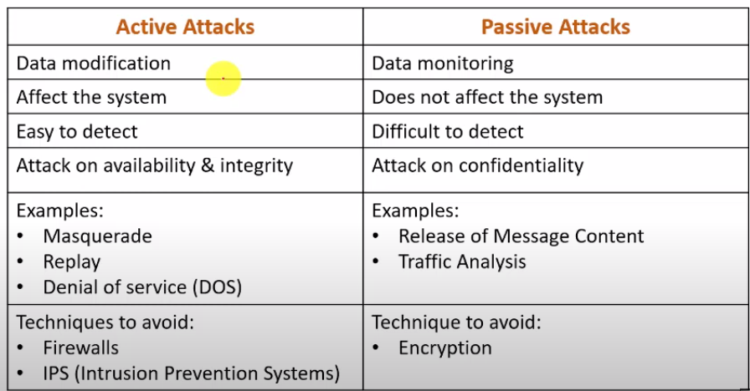

Slide 9
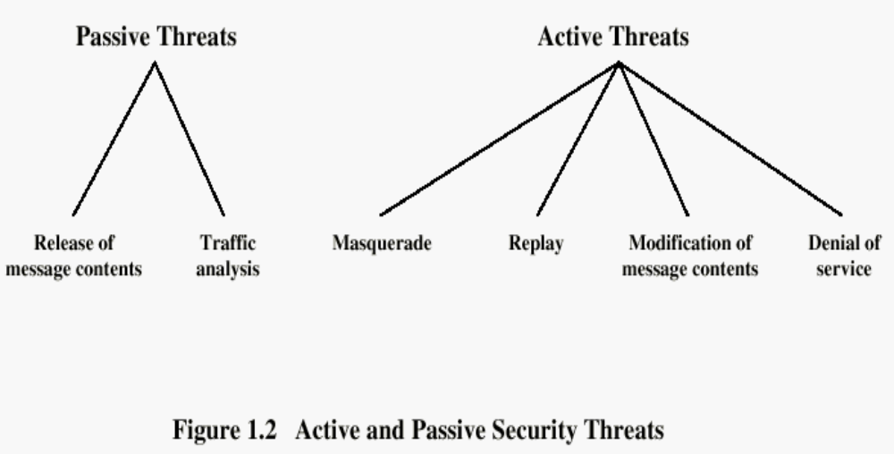

Slide 10
Security Attacks
Interruption: This is an attack on availability
Interception: This is an attack on confidentiality
Modification: This is an attack on integrity
Fabrication: This is an attack on authenticity

Slide 11
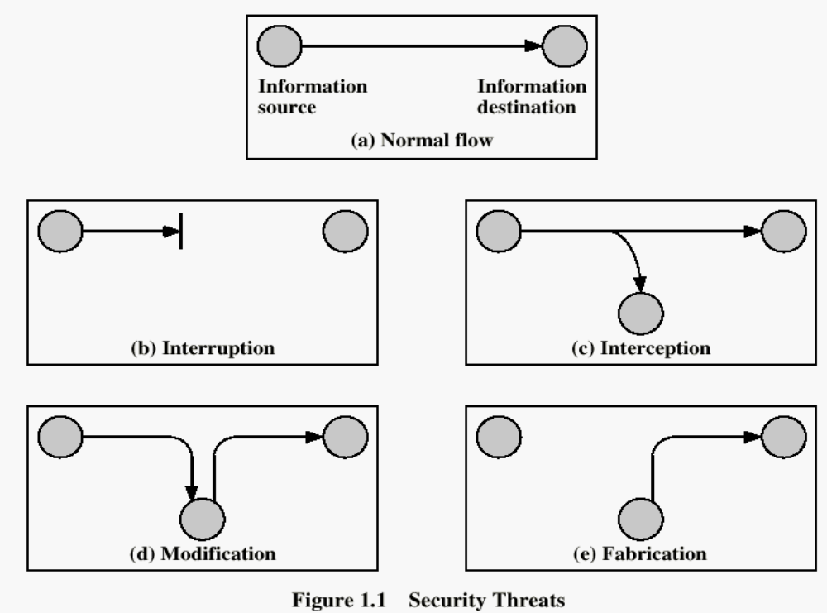
Security Attacks

Slide 12
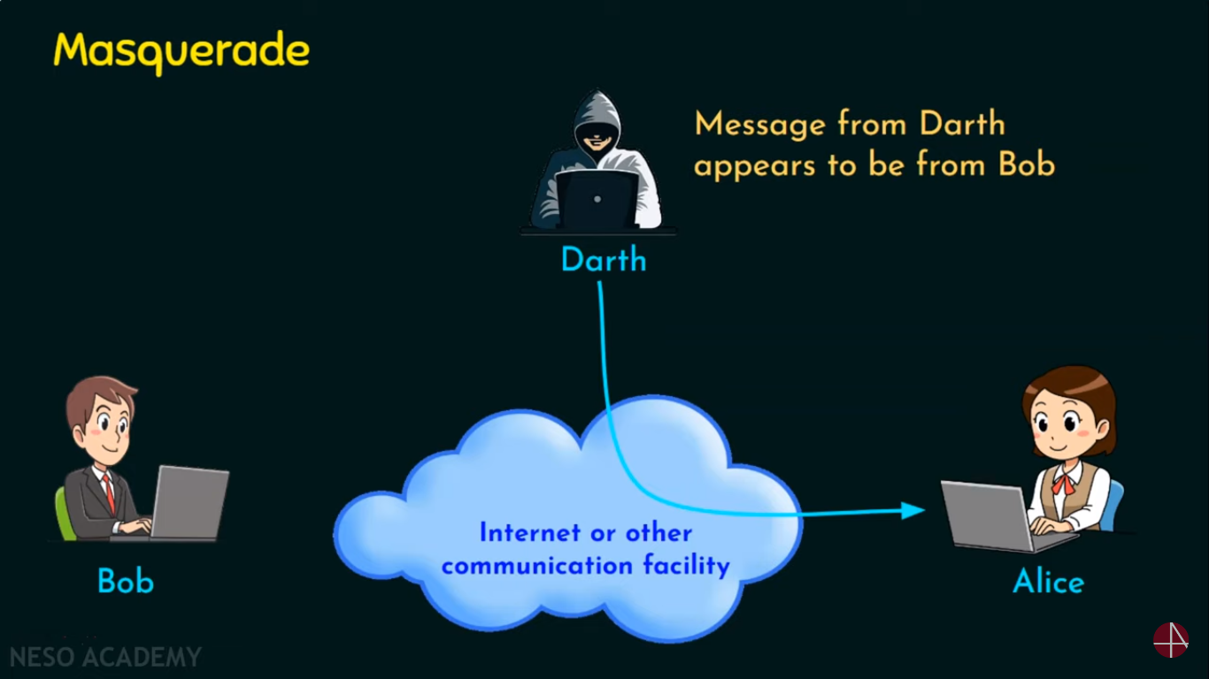
Masquerade Attack

Slide 13
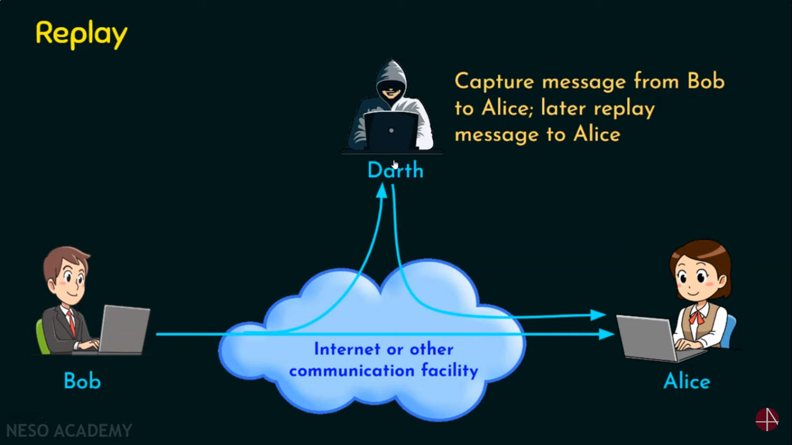
Replay Attack

Slide 14
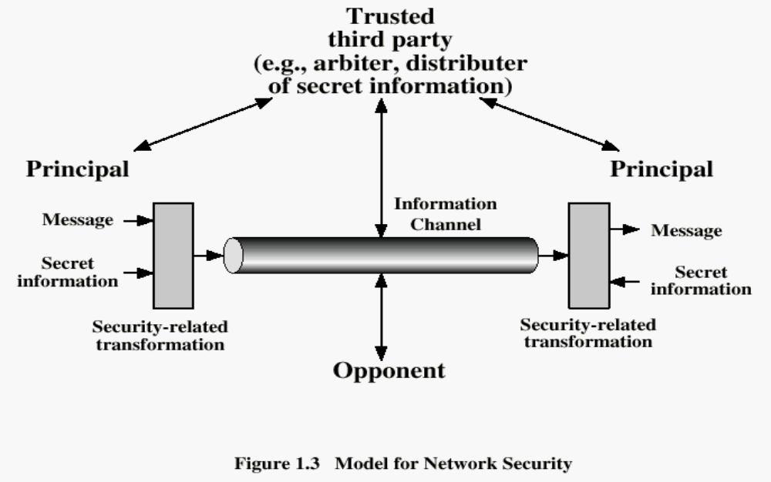

Slide 15
Methods of Defense
Encryption
Software Controls (access limitations in a data base, in operating system protect each user from other users)
Hardware Controls (smartcard)
Policies (frequent changes of passwords)
Physical Controls

